Slide 1
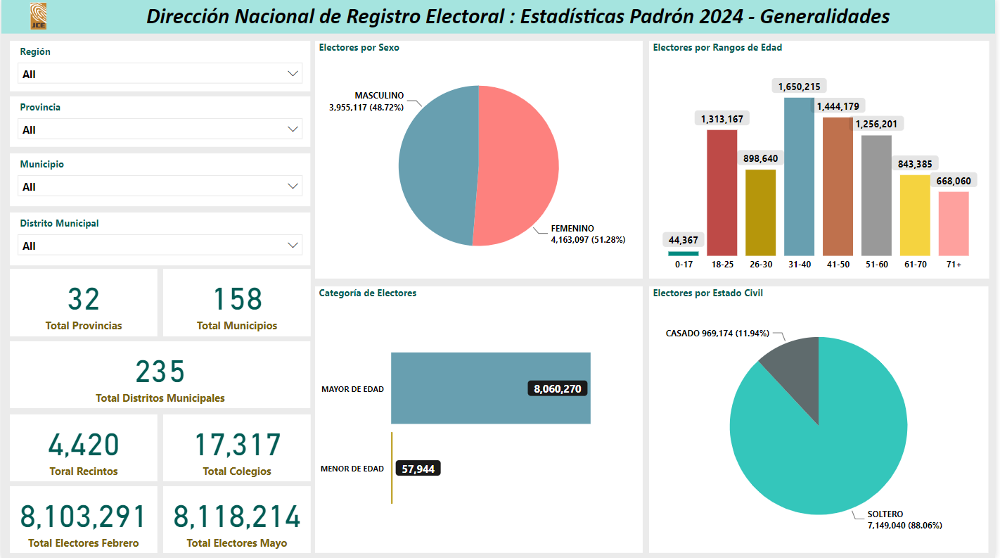

Slide 2
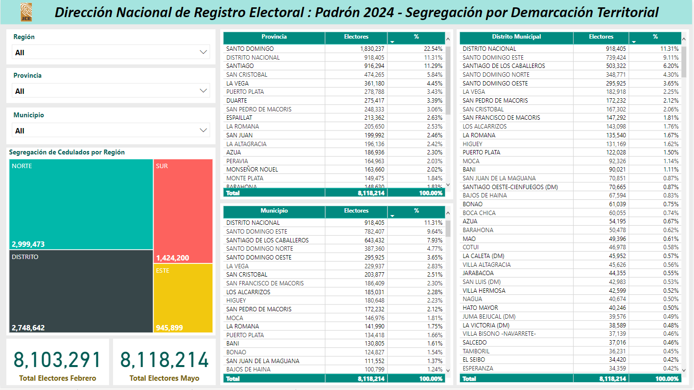

Slide 3
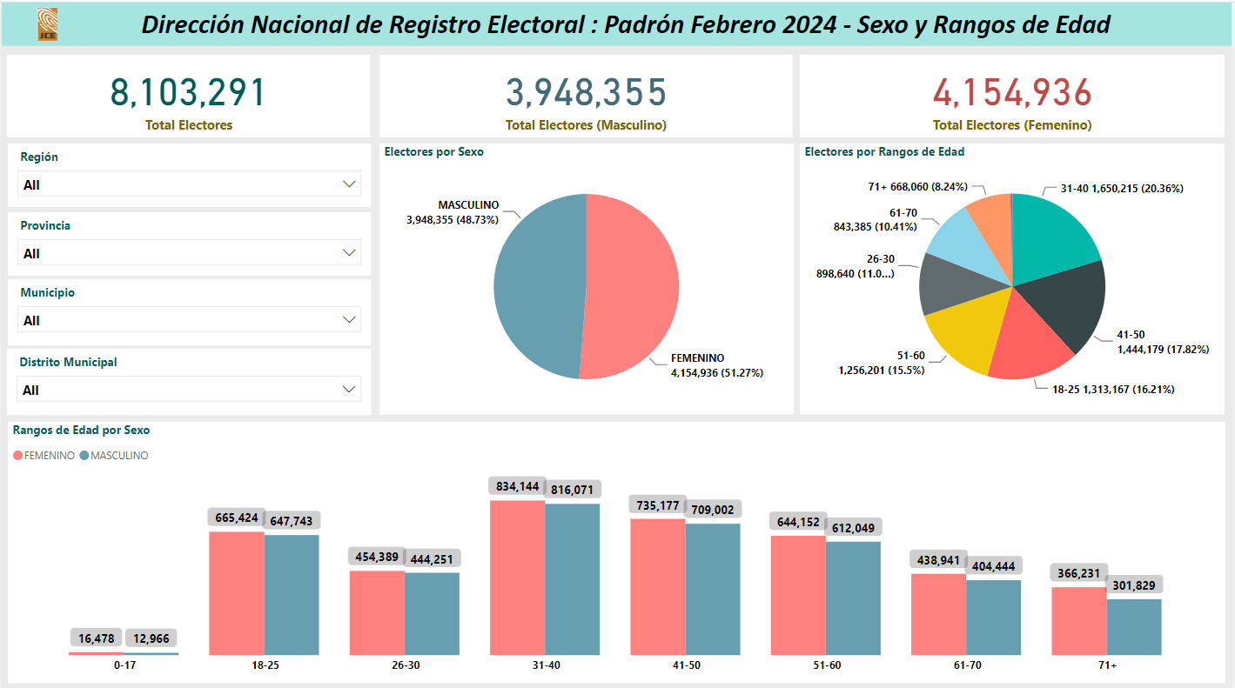

Slide 4
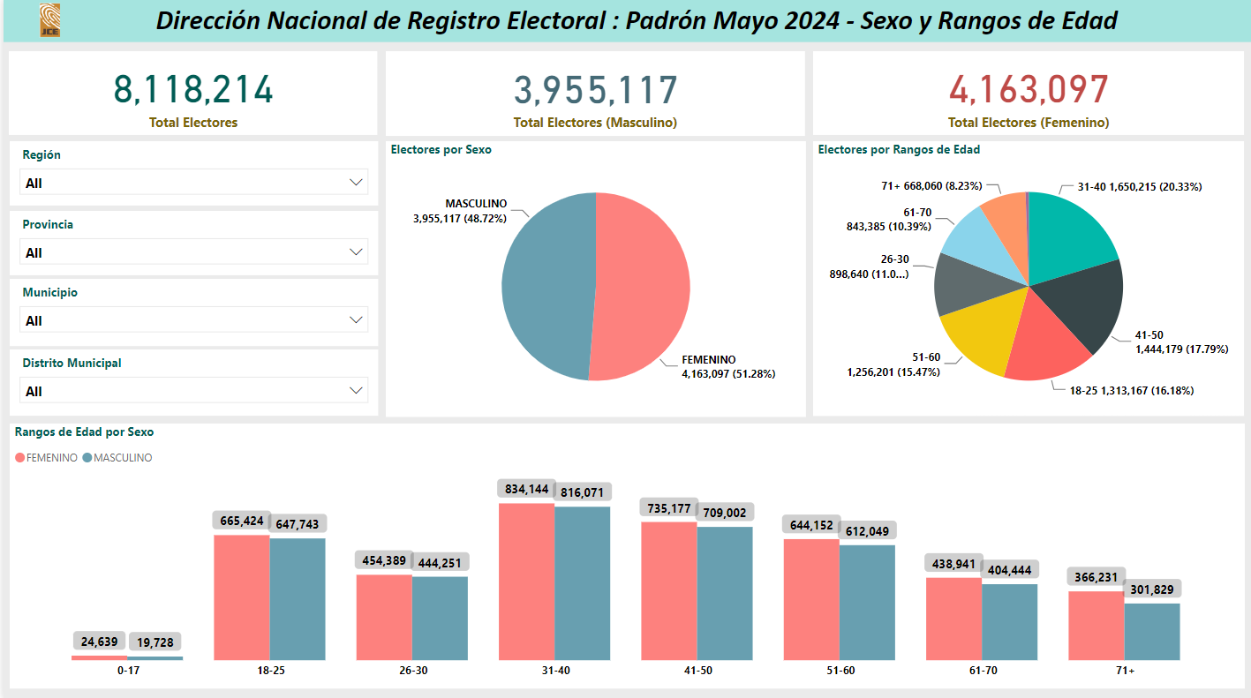

Slide 5
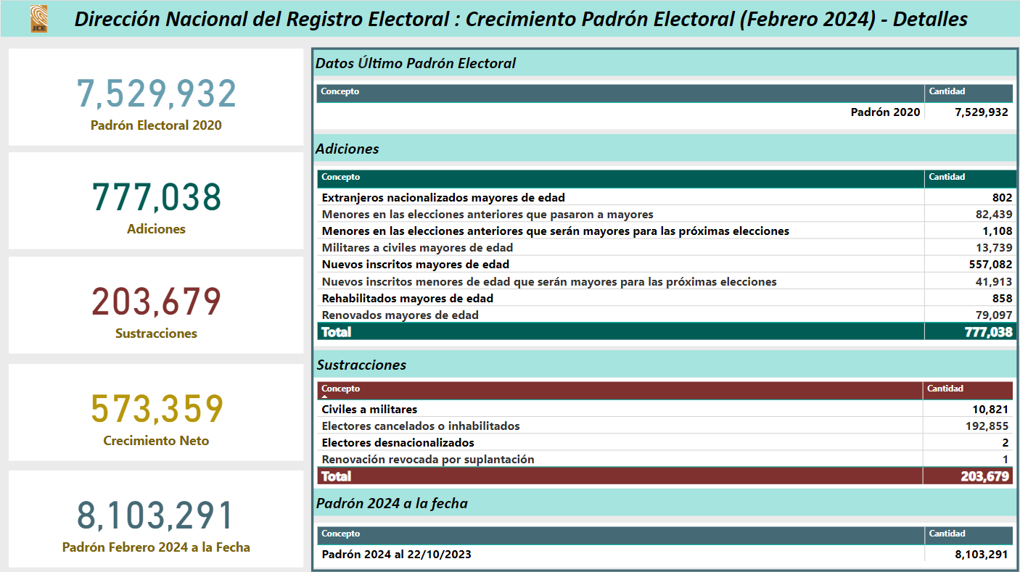

Slide 7
ELECTORES POR PROVINCIA MAYO 2024
Provincia | Electores | %
SANTO DOMINGO | 1,830,237 | 22.54%
DISTRITO NACIONAL | 918,405 | 11.31%
SANTIAGO | 916,294 | 11.29%
SAN CRISTOBAL | 474,265 | 5.84%
LA VEGA | 361,180 | 4.45%
PUERTO PLATA | 278,788 | 3.43%
DUARTE | 275,417 | 3.39%
SAN PEDRO DE MACORIS | 248,333 | 3.06%
ESPAILLAT | 213,362 | 2.63%
LA ROMANA | 205,650 | 2.53%
SAN JUAN | 199,992 | 2.46%
LA ALTAGRACIA | 196,136 | 2.42%
AZUA | 186,936 | 2.30%
PERAVIA | 164,963 | 2.03%
MONSEÑOR NOUEL | 163,660 | 2.02%
MONTE PLATA | 149,475 | 1.84%
BARAHONA | 148,630 | 1.83%
SANCHEZ RAMIREZ | 138,751 | 1.71%
VALVERDE | 135,390 | 1.67%
MARIA TRINIDAD SANCHEZ | 125,898 | 1.55%
HERMANAS MIRABAL | 100,287 | 1.24%
MONTE CRISTI | 92,747 | 1.14%
SAMANA | 85,897 | 1.06%
BAHORUCO | 84,033 | 1.04%
HATO MAYOR | 78,323 | 0.96%
EL SEIBO | 67,982 | 0.84%
DAJABON | 56,641 | 0.70%
SAN JOSE DE OCOA | 55,522 | 0.68%
SANTIAGO RODRIGUEZ | 55,161 | 0.68%
ELIAS PIÑA | 46,699 | 0.58%
INDEPENDENCIA | 42,085 | 0.52%
PEDERNALES | 21,075 | 0.26%
 | 8,118,214

Slide 8
ELECTORES POR PROVINCIA FEBRERO 2024
Provincia | Electores | %
SANTO DOMINGO | 1,826,442 | 22.54%
DISTRITO NACIONAL | 916,768 | 11.31%
SANTIAGO | 914,499 | 11.29%
SAN CRISTOBAL | 473,342 | 5.84%
LA VEGA | 360,557 | 4.45%
PUERTO PLATA | 278,337 | 3.43%
DUARTE | 275,045 | 3.39%
SAN PEDRO DE MACORIS | 247,917 | 3.06%
ESPAILLAT | 213,063 | 2.63%
LA ROMANA | 205,157 | 2.53%
SAN JUAN | 199,547 | 2.46%
LA ALTAGRACIA | 195,630 | 2.41%
AZUA | 186,606 | 2.30%
PERAVIA | 164,675 | 2.03%
MONSEÑOR NOUEL | 163,402 | 2.02%
MONTE PLATA | 149,184 | 1.84%
BARAHONA | 148,351 | 1.83%
SANCHEZ RAMIREZ | 138,544 | 1.71%
VALVERDE | 135,233 | 1.67%
MARIA TRINIDAD SANCHEZ | 125,751 | 1.55%
HERMANAS MIRABAL | 100,206 | 1.24%
MONTE CRISTI | 92,629 | 1.14%
SAMANA | 85,756 | 1.06%
BAHORUCO | 83,870 | 1.04%
HATO MAYOR | 78,217 | 0.97%
EL SEIBO | 67,874 | 0.84%
DAJABON | 56,545 | 0.70%
SAN JOSE DE OCOA | 55,407 | 0.68%
SANTIAGO RODRIGUEZ | 55,114 | 0.68%
ELIAS PIÑA | 46,602 | 0.58%
INDEPENDENCIA | 42,002 | 0.52%
PEDERNALES | 21,019 | 0.26%
 | 8,103,291

